Slide 1
Introduction to .NET
Florin Olariu
“Alexandru Ioan Cuza”, University of Iași
Department of Computer Science

Slide 2
Agenda
Best practices in Web API’s
Fluent Validations
AutoMapper
Starting Microservices or “SOA done right!”
Web API – Demo
Questions

Slide 3
Best practices in Web API’s
Semantic best practices
Technical best practices
Notes:
When we are talking about Best practices in Web API’s we can split it in:

Slide 4
Best practices in Web API’s - Semantic best practices

Slide 5
Best practices in Web API’s - Semantic best practices
Think nouns, not verbs.
Notes:
RESTful APIs are based on nouns — you’re performing actions on endpoints that are things.
Let’s see some examples.

Slide 6
Best practices in Web API’s - Semantic best practices
Think nouns, not verbs.
GET - http://localhost:16991/v1/cities
GET - http://localhost:16991/v1/cities/1/poi
POST - http://localhost:16991/v1/cities/1/poi
PUT - http://localhost:16991/v1/cities/1/poi/3

Slide 7
Best practices in Web API’s - Semantic best practices
Think nouns, not verbs.
Be consistent.
Notes:
That means with HTTP status codes, general API structure, accepted best practices.

Slide 8
Best practices in Web API’s - Semantic best practices
Think nouns, not verbs.
Be consistent.
DO | DO NOT
Use GETs to get data. | Use status codes in a way that is not expected. If returning a set of objects, don’t return 404 if the set is empty — return the empty set. That’s what people expect.
Use PUTs/POSTs to change/add data. | Use GETs to alter data or PUTs/POSTs to only get data.
Pick a few good status codes to use consistently and use them consistently and correctly throughout your API. | Use every status code that tangentially relates to what you’re trying to tell your consumer. Use error messages to describe invalid conditions.
Use the same general endpoint structure throughout.
Notes:
Don’t forget to use versioning.

Slide 9
Best practices in Web API’s - Semantic best practices
Think nouns, not verbs.
Be consistent.
Versioning Web API’s
Notes:
Same samples:

Slide 10
Best practices in Web API’s - Semantic best practices
Think nouns, not verbs.
Be consistent.
Versioning Web API’s
[Route("v1/cities")]
[ApiController]
public class PoiController : ControllerBase
{
}
Notes:
There are a few different ways developers version their API — accept different headers, use a different URL, etc.
The most semantic and clear way to express a version is to put it in your URL, like this: /v2/Cities
In ASP.NET Web API, you can use the Route attribute to do this very easily on your controllers.
Another best practice related to semantic is the following:

Slide 11
Best practices in Web API’s - Semantic best practices
Think nouns, not verbs.
Be consistent.
Versioning Web API’s.
KISS.
Notes:
Keep It Simple, Stupid.
Keep It Stupidly Simple.
We have to follow some basic rules here:

Slide 12
Best practices in Web API’s - Semantic best practices
Think nouns, not verbs.
Be consistent.
Versioning Web API’s.
KISS.
Don’t expose more than you think needs exposing.
Notes:
Keep It Simple, Stupid.
Keep It Stupidly Simple.
We have to follow some basic rules here:
1. Don’t expose more than you think needs exposing. => If a certain property on an object is internal to your business and not useful to a consumer, then don’t return it.

Slide 13
Best practices in Web API’s - Semantic best practices
Think nouns, not verbs.
Be consistent.
Versioning Web API’s.
KISS.
Don’t expose more than you think needs exposing.
Don’t use 43 different status codes .
Notes:
Keep It Simple, Stupid.
Keep It Stupidly Simple.
We have to follow some basic rules here:
Don’t expose more than you think needs exposing => If a certain property on an object is internal to your business and not useful to a consumer, then don’t return it.
Don’t use 43 different status codes => use a few of the most commonly used ones. 200, 201, 302, 404, 400, 500, etc.

Slide 14
Best practices in Web API’s - Semantic best practices
Think nouns, not verbs.
Be consistent.
Versioning Web API’s.
KISS.
Don’t expose more than you think needs exposing.
Don’t use 43 different status codes .
Keep your DTOs simple.
Notes:
Keep It Simple, Stupid.
Keep It Stupidly Simple.
We have to follow some basic rules here:
Don’t expose more than you think needs exposing => If a certain property on an object is internal to your business and not useful to a consumer, then don’t return it.
Don’t use 43 different status codes => use a few of the most commonly used ones. 200, 201, 302, 404, 400, 500, etc.
Keep your DTOs simple => In one particular API I work with, there are four different ways to represent an inactive record.
I don’t mean one property with four different states, I mean four different properties are available to determine whether or not something is considered inactive.
Further, the impact of these four different properties is not well known or explained.

Slide 15
Best practices in Web API’s - Technical best practices

Slide 16
Best practices in Web API’s - Technical best practices
Use DTOs to move data back and forth.
Notes:
An simple example:

Slide 17
Best practices in Web API’s - Technical best practices
Use DTOs to move data back and forth.
public class Poi
{
public int Id { get; set; }
public string Name { get; set; }
public string Description { get; set; }
}
Notes:
For this model the DTO and the action should look like:

Slide 18
Best practices in Web API’s - Technical best practices
Use DTOs to move data back and forth.
public class Poi
{
public int Id { get; set; }
public string Name { get; set; }
public string Description { get; set; }
}
public class PoiForCreatingDto
{
public string Name { get; set; }
public string Description { get; set; }
}
public IActionResult CreatePoi(int cityId, [FromBody] PoiForCreatingDto poi)

Slide 19
Best practices in Web API’s - Technical best practices
Use DTOs to move data back and forth.
Validate everything.
Notes:
Data should always be assumed to be bad until it’s been through some kind of validation process.
Make no assumptions about the data you’re receiving — someone, somewhere will likely send you a request that will break something at some point.
Treat it like you would a UI — always validate your data. Since I always follow technical rule #1, I typically implement IValidatableObject on my DTO and validate using Model.IsValid in the controller.
An small sample for the next DTO and the creating action we should do something like:

Slide 20
Best practices in Web API’s - Technical best practices
Use DTOs to move data back and forth.
Validate everything.
public class PoiForCreatingDto
{
[Required]
[MaxLength(30)]
public string Name { get; set; }
[Required]
[MaxLength(200)]
public string Description { get; set; }
}
Notes:
Data should always be assumed to be bad until it’s been through some kind of validation process.
Make no assumptions about the data you’re receiving — someone, somewhere will likely send you a request that will break something at some point.
Treat it like you would a UI — always validate your data. Since I always follow technical rule #1, I typically implement IValidatableObject on my DTO and validate using Model.IsValid in the controller.
An small sample for the current DTO and the creating action we should do something like:

Slide 21
Best practices in Web API’s - Technical best practices
Use DTOs to move data back and forth.
Validate everything.
[HttpPost("{cityId}/poi")]
public IActionResult CreatePoi(int cityId, [FromBody] PoiForCreatingDto poi)
{
if (poi == null)
{
return BadRequest();
}
if (!ModelState.IsValid)
{
return BadRequest(ModelState);
} … }

Slide 22
Best practices in Web API’s - Technical best practices
Use DTOs to move data back and forth.
Validate everything.
Keep your controllers as thin as possible. Enforce separation of concerns. Separation of concerns means things are testable.
Notes:
Controllers should only do one thing: hand data off to other services to do work for them.
Controllers themselves should only be responsible for moving data to and from your services and should contain no business logic.
Why?
Because the job of a controller is not to know how to process a certain request — the controller should only know who should process a certain request.
This helps keep your controllers and services testable.

Slide 23
Fluent Validations
Notes:
What is Fluent Validations?

Slide 24
Fluent Validations
“A small validation library for .NET that uses a fluent interface and lambda expressions for building validation rules.”
https://github.com/JeremySkinner/FluentValidation
Notes:
How we can install this small library?

Slide 25
Fluent Validations
“A small validation library for .NET that uses a fluent interface and lambda expressions for building validation rules.”
https://github.com/JeremySkinner/FluentValidation
Using: Install-Package FluentValidation.AspNetCore or Nuget package in Visual Studio
Notes:
Example:

Slide 26
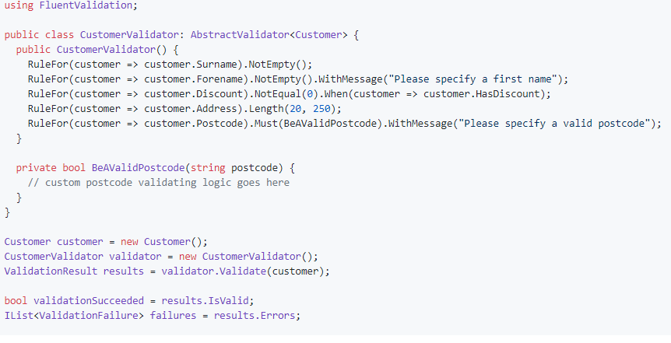
Fluent Validations
“A small validation library for .NET that uses a fluent interface and lambda expressions for building validation rules.”
https://github.com/JeremySkinner/FluentValidation
Using: Install-Package FluentValidation.AspNetCore or Nuget package in Visual Studio

Slide 27
AutoMapper

Slide 28
AutoMapper
“AutoMapper uses a fluent configuration API to define an object-object mapping strategy. AutoMapper uses a convention-based matching algorithm to match up source to destination values. AutoMapper is geared towards model projection scenarios to flatten complex object models to DTOs and other simple objects, whose design is better suited for serialization, communication, messaging, or simply an anti-corruption layer between the domain and application layer.” -> http://docs.automapper.org/en/stable/index.html

Slide 29
AutoMapper
https://dotnetcademy.net/Learn/2/Pages/2

Slide 30
Starting Microservices or “SOA done right!”
Notes:
Buy a banana holder ….
If a page like this exists I would ask myself:

Slide 31
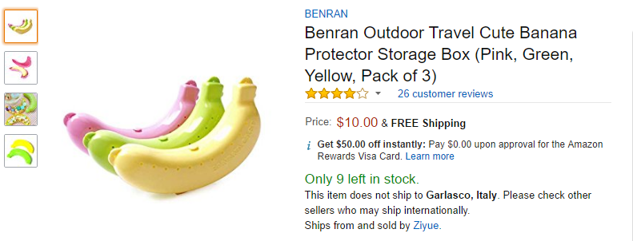
Starting Microservices or “SOA done right!”
Copyright : Mauro Servienti => “SOA dine right!”
Notes:
Buy a banana holder ….
If a page like this exists I would ask myself:

Slide 32
Starting Microservices or “SOA done right!”
Who is in charge of changing, for example, the price?
Who is responsible for business rules affecting shipping costs?
Where do we store stars and customers’ reviews?

Slide 33
Starting Microservices or “SOA done right!”
Marketing
Copyright Mauro Servienti => “SOA done right!”
Sales
Shipping
Warehouse
Publishing
Notes:
“All I want to do when I wake up in the morning is...” …

Slide 34
Starting Microservices or “SOA done right!”
(micro)services owning their own piece of information. Single Responsibility Principle
Notes:
“All I want to do when I wake up in the morning is...” …

Slide 35
Starting Microservices or “SOA done right!”
Marketing
Sales
Shipping
Warehouse
Publishing
PK 1
PK 1
PK 1
PK 1
PK 1
ViewModel
Client
/products/
1

Slide 36
Starting Microservices or “SOA done right!”
Much more next time … ☺

Slide 37
Web API
Flights - Demo

Slide 38
One more thing…

Slide 39
One more thing…
Rules of Optimization: Rule 1: Don't do it. Rule 2 (for experts only): Don't do it yet.

Slide 40
Bibliography
Pluralsight
Mauro Servienti – “SOA done right!”

Slide 41


Slide 42
Thanks!
See you next time! ☺

